Slide 1
CLAIMS MANAGEMENT SYSTEM

Slide 2
TABLE OF CONTENTS
OVERVIEW
FEATURES
ARCHITECTURE
Problem STATEMENT
01
02
03
04
05
06
TECHNOLOGY
A CLOSER LOOK

Slide 3
OUR TEAM
RANJIT KUMAR YADAV
AYUSHI JAGTAP
SHIVANEE PATIDAR
PRIYANKA JAISWAL

Slide 4
01
PROBLEM STATEMENT

Slide 5
PROBLEM STATEMENT
A leading HealthCare Management Organization wants to strengthen its middleware by exposing the core logic related to Claims Management as Microservices.
The middleware Microservices are to be hosted on Cloud.
Member Portal to be developed that consumes these Microservices and responds back to members who are in need of Claim related information.

Slide 6
02
OVERVIEW

Slide 7
LIST OF MICROSERVICES
1) MEMBER PORTAL
2) AUTHORIZATION MICROSERVICE
3) MEMBER MICROSERVICE
4) CLAIMS MICROSERVICE
5) POLICY MICROSERVICE

Slide 8
03
FEATURES

Slide 9
FEATURES
SubMIT Claim
The user can insert the claim details like :
ID
Hospital Name
Claim Amount
A claim ID will be generated corresponding to the submitted claim.
CHECK StATus
The user can check the status of a particular claim with the given claim ID. For instance, Claim is pending as more documents are needed for verification.
View bills
The User can see if he/she has any pending bills along with the last premium paid date and late charges

Slide 10
04
ARCHITECTURE

Slide 11
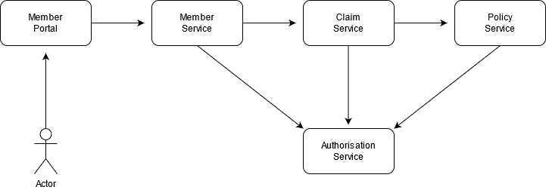
ARCHITECTURE/FLOW DIAGRAM

Slide 12
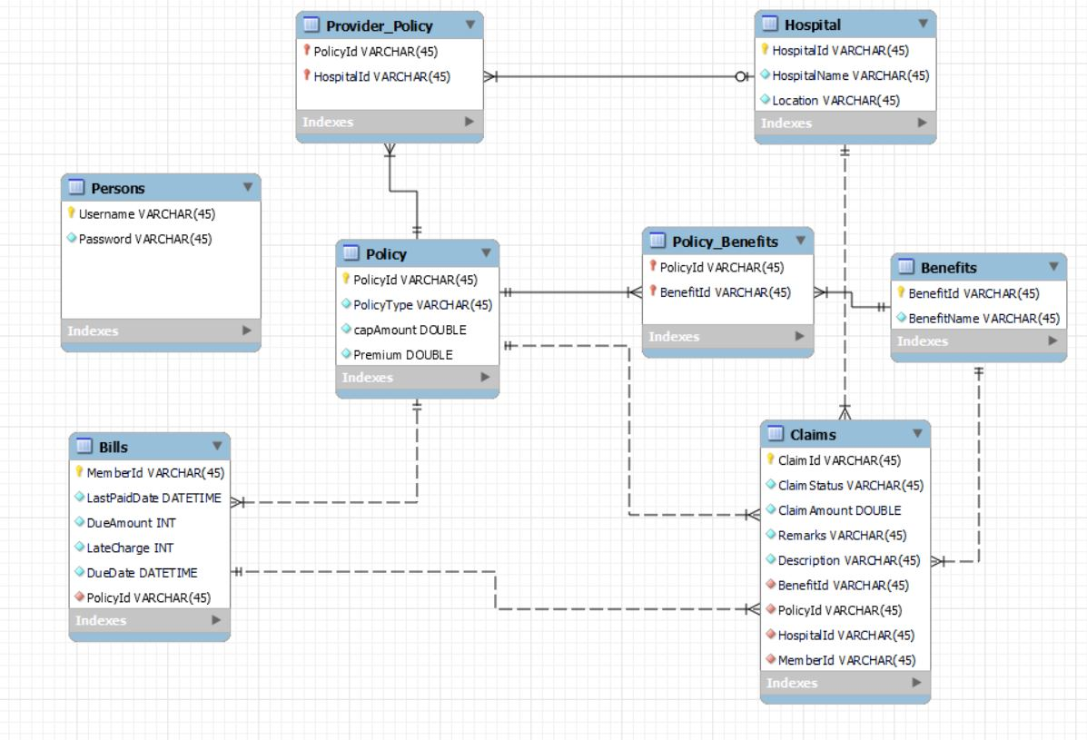
DataBase Schema
Helena james
Jenna doe
“Venus has a beautiful name and is the second planet
from the Sun. It’s terribly hot”

Slide 13
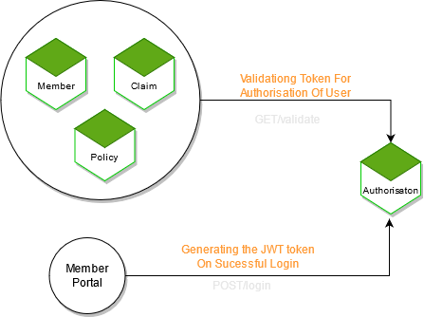
AUTH MODULE

Slide 14
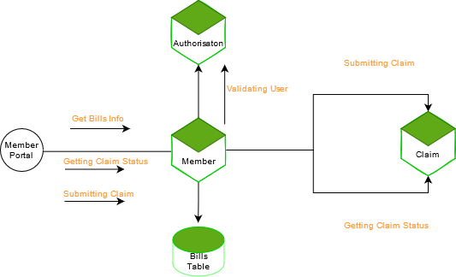
MEMBER MODULE

Slide 15
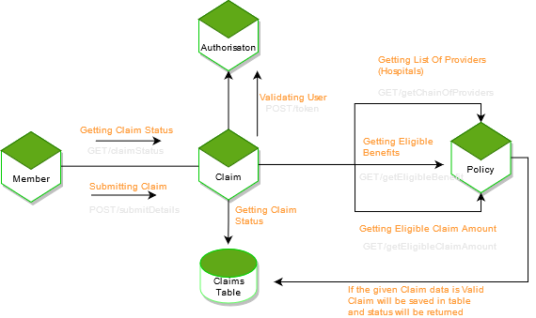
CLAIMS MODULE

Slide 16
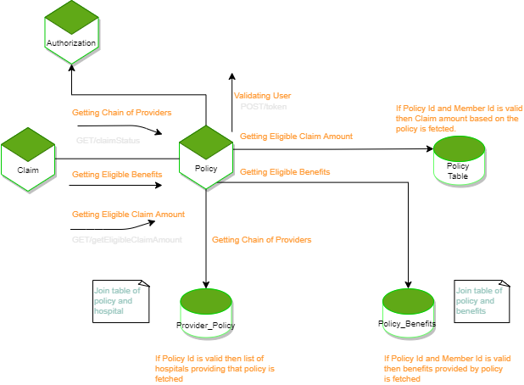
POLICY MODULE

Slide 17
05
TECHNOLOGY

Slide 18
TECHNOLOGY/FRAMEWORKS USED
FRONTEND
BACKEND
Angular
Spring MVC with Spring Boot
Spring Data JPA, H2 In Memory DB
TESTING
jUnit 4/jUnit 5
Mockito

Slide 19
DEVOPS & CLOUD
ANCILLARY
Docker
AWS CI/CD
AWS ECS
AWS S3
Maven
Lombok
CODE QUALITY
SonarQube
SonarLint

Slide 20
07
A CLOSER LOOK

Slide 21
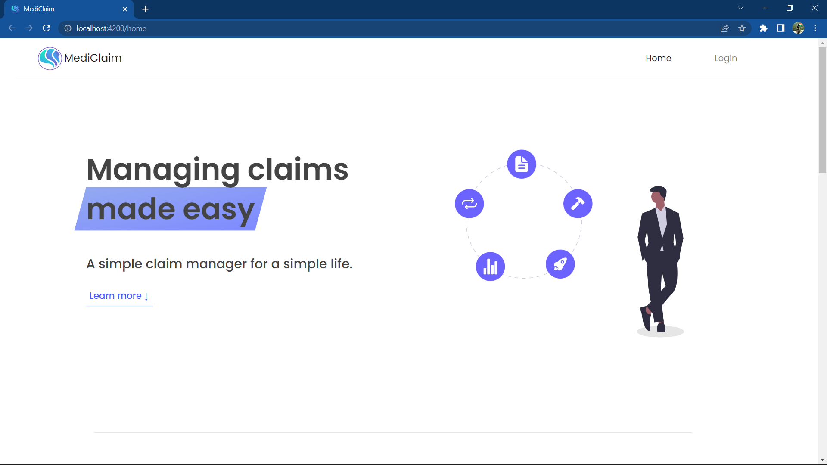
MEMBER PORTAL

Slide 22
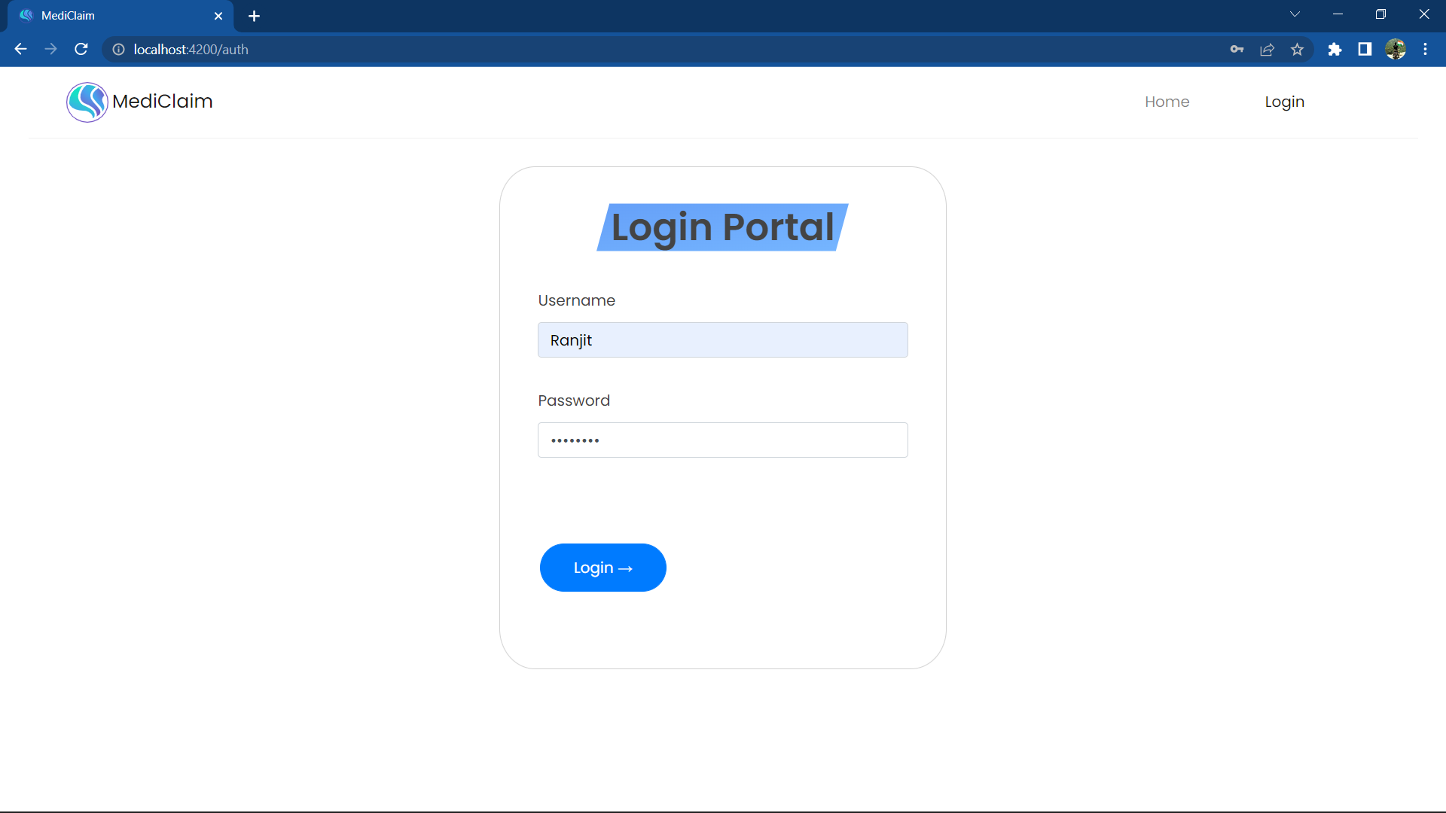
Login Portal

Slide 23
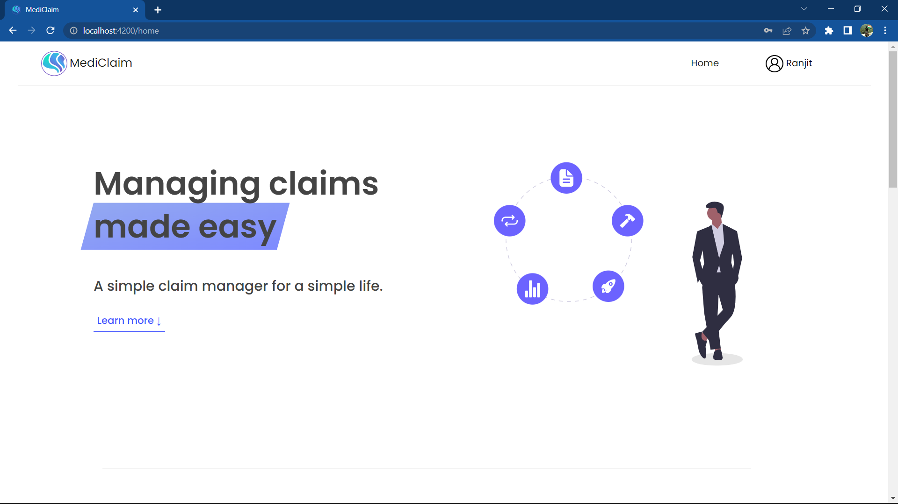
User Account

Slide 24

Main Features

Slide 25
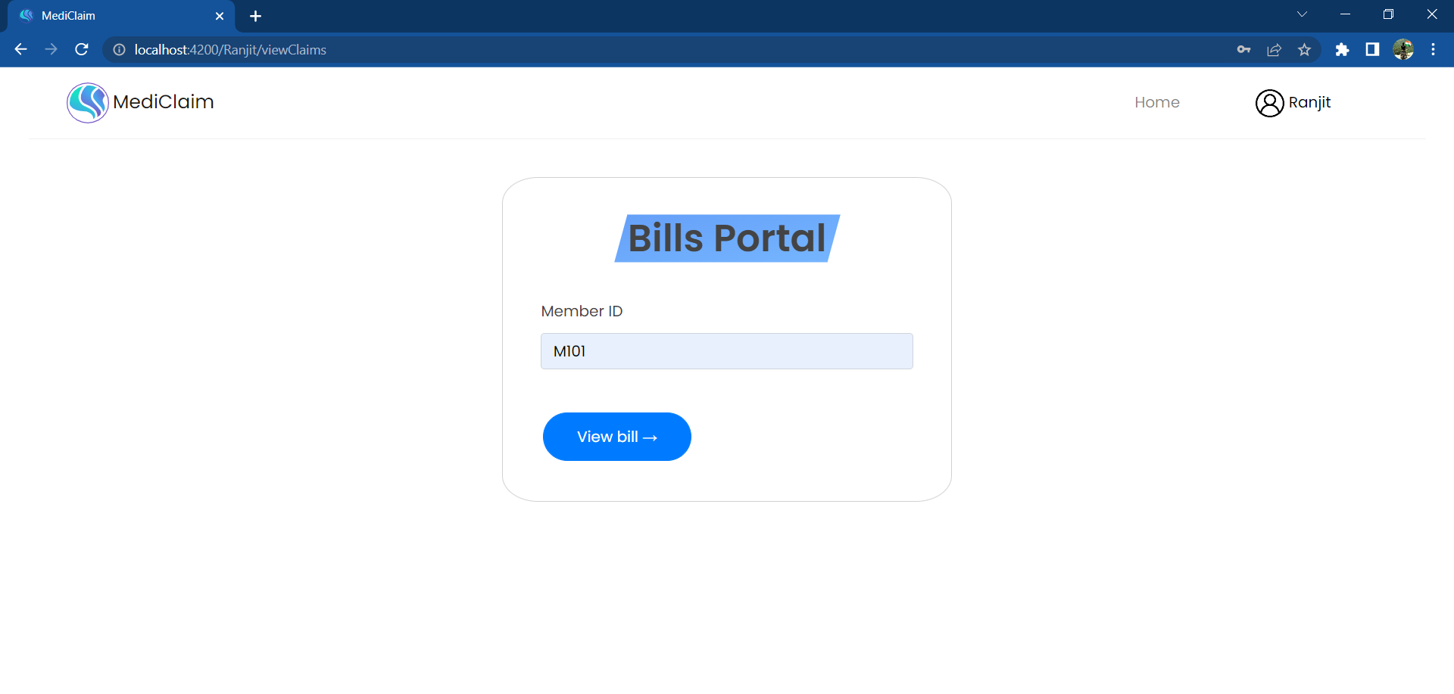
Bills Portal

Slide 26
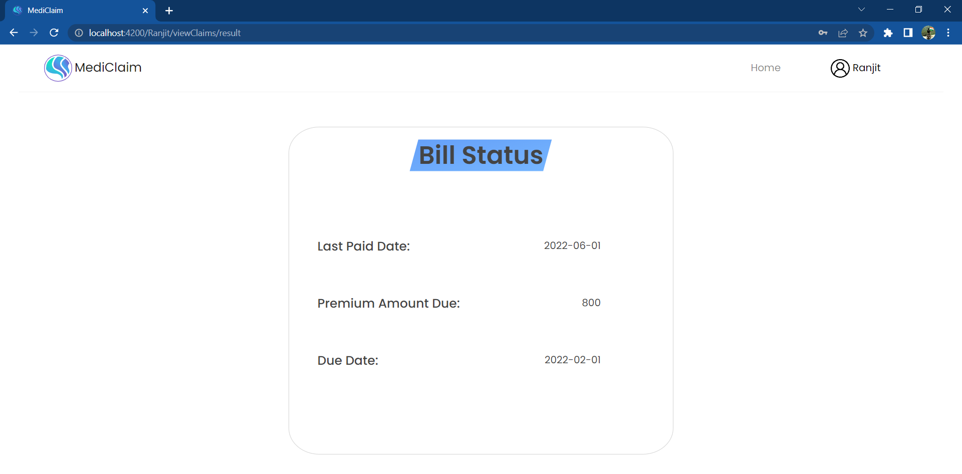
Bills Status

Slide 27
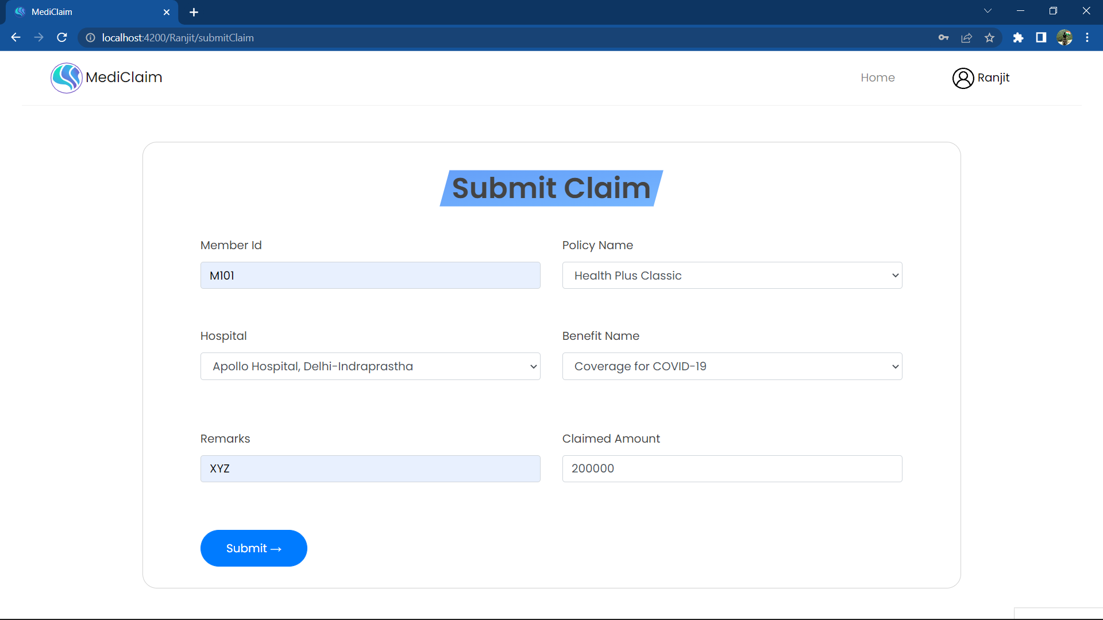
Submit Claim

Slide 28
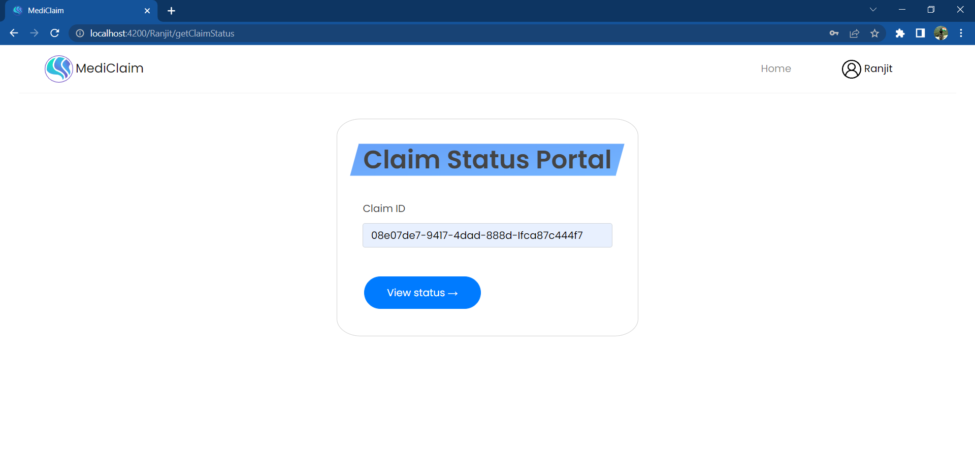
Claim Status Portal

Slide 29
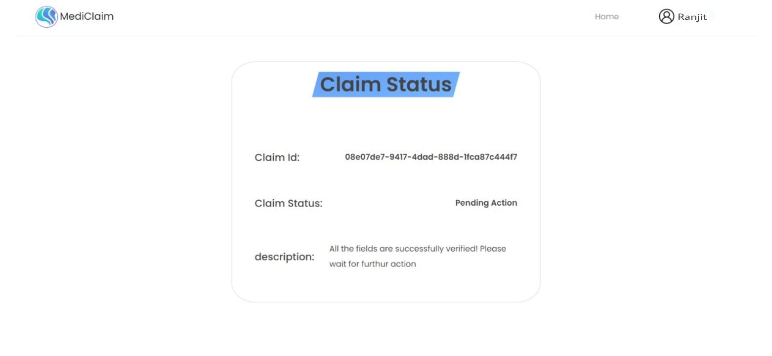
Claim Status

Slide 30
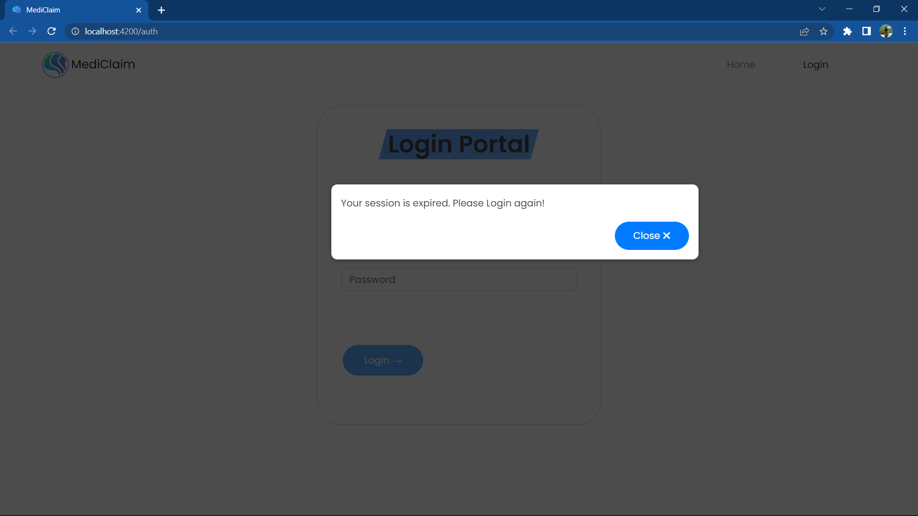
Session Expired After 15 Minutes

Slide 31
THANK YOU!

